Slide 1
Sprint 2 Retrospective
SEP Team 5

Slide 2
Things That We Did Well

Slide 3
Caught up on Sprint 1 tasks
All tasks from sprint 1 are now complete and additional tasks to get us set up for sprint 3 were completed

Slide 4
Pro-active Dependency and Resource Adding
Many crucial things were accomplished within the first week
Dependencies were added
Examples of pages and application structure
Database entities

Slide 5
Modular and Robust Code Features
External files containing commonly reused features
Enums for monster related information
Cookie handling class
91% Code Coverage (Sprint 1) → 95% Code Coverage (Sprint 2)
Notes:
What Went Right

Slide 6
Team Member Capacity
No one was extremely overworked or had excessive tasks leftover at the end of the sprint

Slide 7
Story and Feature Break Down (Sprint 2)
React Router Set Up
Creating a Catalog Monster
Integrated login and registration (Sprint 1 leftover tasks)
Creating an Encounter (backend)
Finish dockerizing the application backend for local development
Deploy to AWS
Data parsing and importing tasks for database, migrations
Database Entity set up for Monsters and Encounters (Sprint 2 and 3 tasks)

Slide 8
Things That We Didn’t Do Well

Slide 9
Dev Workstation Setup
Workstations were only set up for the tasks that the developer was working on (frontend, backend, server)
Workstation setup was delayed until the end of the first week while completing current tasks
Delayed pull requests

Slide 10
Team Member Capacities
We took into account absences but not when those absences were
Two team members were only here the first 2 days and the last 2-3 days of the sprint
Limited development time and impact on burndown rate
Development time went a little over the end of the sprint (last pull request at 4am on Saturday)

Slide 11
Pull Request Review Response Time
Due to half of the team being gone the first week, pull requests review capacity was limited
Request review ability was also limited by workstation setup
Request review conversations mainly took place in Discord for ease of conversation
Notes:
What Went Wrong and Can Be Improved

Slide 12
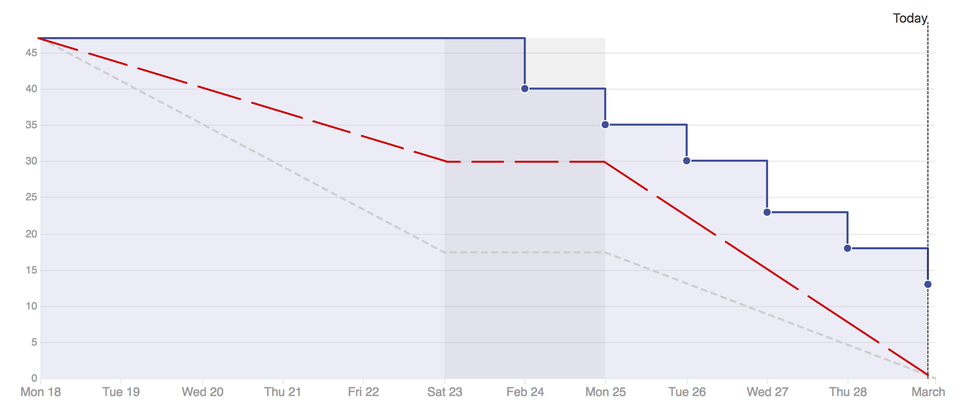
Burndown Rate
Our planned burn down rate (taking into account missing team members)

Slide 13
Actions We’ll Take to Improve Next Sprint

Slide 14
Workstation Setup
We’re meeting as a team early this week to go over complete workstation setup
Catching up teammates who were gone and solidifying understanding

Slide 15
Pull Request Review Response Time &
Burndown Rate Catch Up
Ensure workstations are set up for all aspects of the project
Ensure someone is always available and ready to review incoming pull requests
Ensure pull request conversations (or at least summaries of them) happen on GitHub
Notes:
How We’re going to Fix what went wrong / what will we commit to next sprint

Slide 16
Team Member Capacities
If someone is going to be gone for most of the sprint, ensure that the groundwork is laid out for their task first to allow for a smooth finish for tasks

Slide 17
Outcome

Slide 18
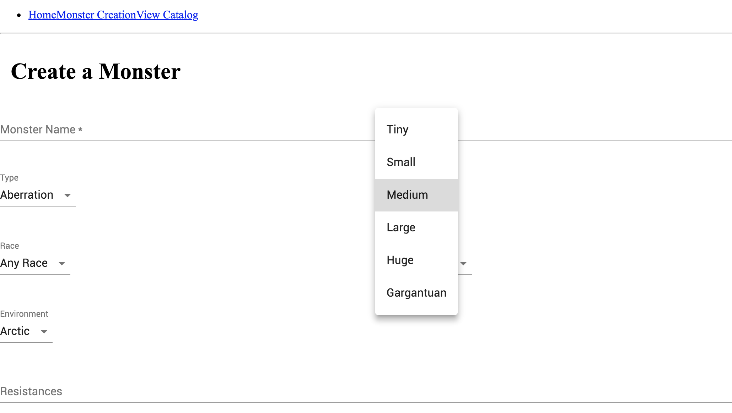
Monster Creation Page
WIP
NavBar
54 inputs with various constraints

Slide 19
Questions?

